Slide 1

Topic-Sensitive PageRank
University of Belgrade
School of Electrical Engineering
Presented by :
Bratislav V. Stojanović
unimatrix0@live.com
Page 1/29

Slide 2
Introduction
The World Wide Web is growing rapidly
There are more than 100 million websites and more than 10 billion pages over there!
We didn’t mention the content that cannot be indexed by standard search engines (Deep web)!
For example, if we type the word “golf” inside Google, we will end up with around 456 million results!
Other search engines will yield more or less different results. Why?
“What makes the foundation of the search engine?”
“Why do we prefer one search engine over another?”
Bratislav Stojanović (unimatrix0@live.com) | Page 2/29

Slide 3

Problem Definition
“How can we find exactly what we want on the WWW in a fast and efficient matter?”
Every search engine needs to rank pages, but how?
  Bigger the value means the page has more content?
  Bigger the value means query words are more frequent?
  Bigger the value means the page is more important?
Every page has its own rank of importance, but what is importance?
  Traffic analysis?
  Financial statement analysis?
  Link structure analysis?
  $$$?
Bratislav Stojanović (unimatrix0@live.com) | Page 3/29

Slide 4
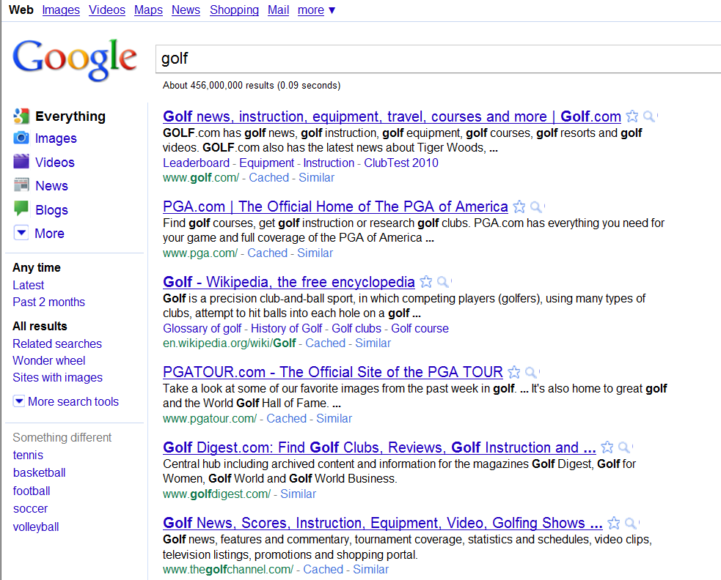
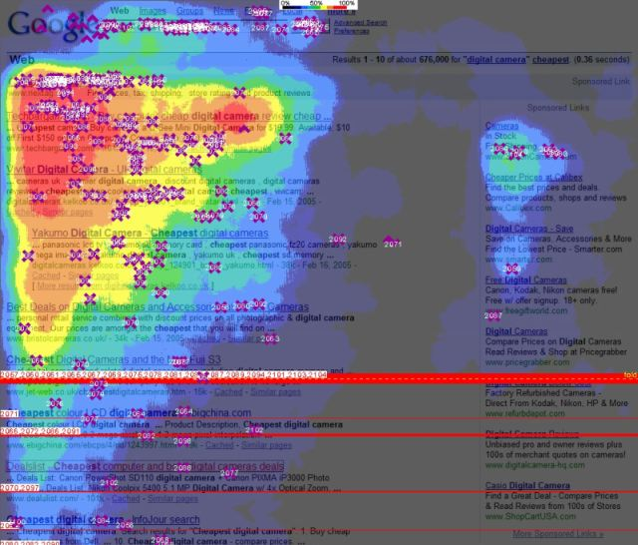
Problem Importance
What will be the result of the query “golf”?
Where do users click more often?
Nearly 90% of traffic to most web sites is found by using a search engine or directory
Bratislav Stojanović (unimatrix0@live.com) | Page 4/29

Slide 5
Problem Trend
Our everyday life is cluttered with a tons of different informations
Finding a real information has become even more difficult
There has been a couple of million new web sites added, only in the last year!
Google is the most popular website, and the second most visited website on the planet!
Bratislav Stojanović (unimatrix0@live.com) | Page 5/29

Slide 6
Existing Solutions
HITS (Hyperlink-Induced Topic Search)
HyperSearch
PageRank
Hilltop
SALSA (Stochastic Approach for Link Structure Analysis)
TrustRank
And many other variants…
Bratislav Stojanović (unimatrix0@live.com) | Page 6/29

Slide 7
Solution #1 : HITS
Hubs and Authorities
John M. Kleinberg, Cornell University, NY, ’98
Reflects the time when the internet was originally forming
Two types of pages :
  Hubs
  Authorities
Hub page provides links to good authorities on the subject
Authority page provides a good information about the subject
Bratislav Stojanović (unimatrix0@live.com) | Page 7/29

Slide 8
Solution #1 : HITS
Criticism :
  ☹ Expensive at runtime
  ☹ Scores are calculated using subgraph of the entire Web graph
  ☺ Simple and iterative
  ☺ Query-specific rank score
Bratislav Stojanović (unimatrix0@live.com) | Page 8/29

Slide 9
Solution #2 : PageRank
Lawrence “Larry” Page, Sergey Brin, Stanford, 1998
Used by the Google search engine
Uses a random surfer model
Represents the likelihood that a person randomly clicking on links will arrive at any particular page
Probability distribution is evenly divided among all pages in the Web graph
PageRank value is computed for each page offline
Interprets a hyperlink from page i to page j as a vote, by page i, for page j
Analyzes the page that casts the vote as well
Bratislav Stojanović (unimatrix0@live.com) | Page 9/29

Slide 10
Solution #2 : PageRank
“Page is important if many important pages point to it”
Simplified PageRank formula :
  r = PR(G)
Input : Web graph G = (V,E)
Output : Rank vector r
Let G have n nodes (pages)
In-links of page i :
  Hyperlinks that point to page i from other pages
Out-links of page i :
  Hyperlinks that point out to other pages from page i
Bratislav Stojanović (unimatrix0@live.com) | Page 10/29

Slide 11
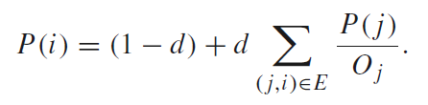

Solution #2 : PageRank
Original PageRank formula :
Damping factor d = 0.85
More general formula :
Recursive definition!
Equation of the eigensystem, where the solution to P is an eigenvector with the corresponding eigenvalue of 1
Computation can be done using power iteration method
Bratislav Stojanović (unimatrix0@live.com) | Page 11/29
Notes:
The PageRank theory holds that even an imaginary surfer who is randomly clicking on links will eventually stop clicking. The probability, at any step, that the person will continue is a damping factor d. Various studies have tested different damping factors, but it is generally assumed that the damping factor will be set around 0.85.
Eigensystem is a concept from linear algebra. Linear algebra studies linear transformations. Linear transformation is a function between two vector spaces that preserves vector addition and scalar multiplication.

Slide 12
Solution #2 : PageRank
1
1
1.83
1.325
1.27
1
1.83
1.325
1.27
0.33
1.522
0.33
0.61
0.442
1
1.83
1.325
1.27
 | P1 | P2 | P3 | P4
I1 | 1 | 1 | 1 | 1
I2
I3
I4
I5
 | P1 | P2 | P3 | P4
I1 | 1 | 1 | 1 | 1
I2 | 1 | 1.83 | 0.33 | 0.83
I3
I4
I5
 | P1 | P2 | P3 | P4
I1 | 1 | 1 | 1 | 1
I2 | 1 | 1.83 | 0.33 | 0.83
I3 | 1.83 | 1.325 | 0.33 | 0.495
I4
I5
 | P1 | P2 | P3 | P4
I1 | 1 | 1 | 1 | 1
I2 | 1 | 1.83 | 0.33 | 0.83
I3 | 1.83 | 1.325 | 0.33 | 0.495
I4 | 1.325 | 1.27 | 0.61 | 0.775
I5
 | P1 | P2 | P3 | P4
I1 | 1 | 1 | 1 | 1
I2 | 1 | 1.83 | 0.33 | 0.83
I3 | 1.83 | 1.325 | 0.33 | 0.495
I4 | 1.325 | 1.27 | 0.61 | 0.775
I5 | 1.27 | 1.522 | 0.442 | 0.747
0.33
0.33
0.61
0.442
0.33
0.33
0.61
0.442
1
0.83
0.495
0.775
0.5
0.165
0.165
0.305
0.5
0.165
0.165
0.305
DEPENDS!
Converges?
1
0.33
0.33
0.61
0.442
1
0.83
0.495
0.775
0.747
Bratislav Stojanović (unimatrix0@live.com) | Page 12/29

Slide 13
Solution #2 : PageRank
Criticism :
  ☹ Query independent rank score
  ☹ Random surfer model not appropriate in some situations
  ☹ Prone to manipulations (Google bombs, link farms…)
  ☺ Inexpensive at runtime
  ☺ Scores are calculated using the entire Web graph
  ☺ Algorithm has hooks for “personalization”
Bratislav Stojanović (unimatrix0@live.com) | Page 13/29

Slide 14
Solution #3 : TrustRank
Gyöngyi, Garcia-Molina, Pedersen, Stanford & Yahoo!, 2004
Link analysis algorithm
Finds motivation in PageRank manipulation
Used to semi-automatically separate useful webpages from spam
Web spam pages are created only with the intention of misleading search engines
Human experts can easily identify spam pages, but it’s too expensive to manually evaluate everything
Bratislav Stojanović (unimatrix0@live.com) | Page 14/29

Slide 15
Solution #3 : TrustRank
Select a small set of seed pages to be evaluated by an expert
Now, extend outward from the seed set and seek similar pages by using links
Alternatively, we can pick a small set of spam pages
TR can be used to calculate spam mass
Spam mass is the measure of the impact of link spamming on a page ranking
Instead of PR, we calculate Inverse PR
“Pages are bad if they link to bad pages”
Bratislav Stojanović (unimatrix0@live.com) | Page 15/29

Slide 16
Solution #3 : TrustRank
Criticism :
  ☹ Semi-automated separation of reputable, good pages from spam pages
  ☺ In contrast to PR, TR differentiates good and bad pages
  ☺ Based on a good seed set of less than 200 pages, results have shown that TR can effectively filter out spam
Bratislav Stojanović (unimatrix0@live.com) | Page 16/29

Slide 17
Proposed Solution
TSPR (Topic-Sensitive PageRank)
Taher H. Haveliwala, Stanford University, 2003
“Personalized” version of PageRank
  Instead of computing a single rank vector, why don’t we compute a set of rank vectors, one for each (basis) topic?
Uses the Open Directory Project as a source of representative basis topics (http://www.dmoz.org) or Yahoo!
Calculate in two steps, fully automatically :
  Pre-processing
  Query-processing
Preprocessing step is calculated offline, just as with ordinary PageRank
Bratislav Stojanović (unimatrix0@live.com) | Page 17/29

Slide 18
Is it better?
☺ Query-specific rank score
☺ Fully automated
☺ Make use of context
☺ Still inexpensive at runtime
Bratislav Stojanović (unimatrix0@live.com) | Page 18/29

Slide 19
Is it original?
The first topic-sensitive personalization of PageRank
Source of ideas for many other possible personalizations
Taher got a job at Google Inc. in 2003 as a member of Search Quality Group
Cited 994 times on Google Scholar
Bratislav Stojanović (unimatrix0@live.com) | Page 19/29

Slide 20
Trend
Search in context and semantic web are very popular topics nowadays
They will certainly play a significant role in the next step of the World Wide Web evolution
The Semantic Web as a global vision has remained largely unrealized
There is a belief that Web 3.0 will dramatically improve the functionality and usability of search engines
Bratislav Stojanović (unimatrix0@live.com) | Page 20/29

Slide 21
Topic-Sensitive PageRank 1/7
PageRank formula :
  r = PR(G)
Topic-Sensitive PageRank formula :
  r = IPR(G,v)
IPR stands for “Influenced” PageRank
Input :
  Web graph G = (V,E)
  Influence vector is a vector of basis topics t
Output :
  List of rank vectors r
It maps page i to :
  page i importance, WRT topic t_{i}
Bratislav Stojanović (unimatrix0@live.com) | Page 21/29

Slide 22
Topic-Sensitive PageRank 2/7
For the sake of simplicity, let’s consider some page i and only 16 topics (categories) :
  We can pick them from the first level of ODP
Step 1 is performed once, offline, during Web crawl
It uses the following iterative approach :
For each topic c_{j} ε v
{
// Part 1 : Calc v_{j}
v_{j}[ i ] = 0;
if ( i ε pages(c_{j}) ) {
v_{j}[ i ] = 1 / num( pages(c_{j}) )
}
// Part 2 : Calc r_{j}
r_{j}[ i ] = IPR(W, v_{j}[ i ]);
}
Bratislav Stojanović (unimatrix0@live.com) | Page 22/29

Slide 23
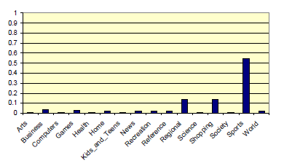
Topic-Sensitive PageRank 3/7
Step 2 assumes that we calculate some distribution of weights over the 16 topics in our basis
Only the link structure of pages relevant to the query topic will be used to rank page i
Example : Query is “golf”
With no additional context, the distribution of topic weights we would use is :
Bratislav Stojanović (unimatrix0@live.com) | Page 23/29

Slide 24
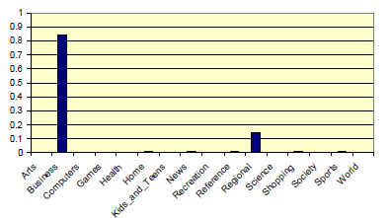
Topic-Sensitive PageRank 4/7
If user issues queries about investment opportunities, a follow-up query on “golf” should be ranked differently, with the business-specific rank vector
Example : Query is “golf”, but the previous query was “financial services investments”
Distribution of topic weights we would use is :
Bratislav Stojanović (unimatrix0@live.com) | Page 24/29

Slide 25


Topic-Sensitive PageRank 5/7
At the end, calculate the composite PageRank score using the following formula :
Interpretation of the composite score :
Weighted sum of rank vectors itself forms a valid rank vector
The final score can be used in conjuction with other scoring schemes
Bratislav Stojanović (unimatrix0@live.com) | Page 25/29

Slide 26
Topic-Sensitive PageRank 6/7
0.33
1
1
1
Topic : Sports
1
Topic : Business
1
1
Topic : Business
1
 | P1 | P2 | P3 | P4 | P5 | P6 | P7
I1 | 1 | 1 | 1 | 1 | 1 | 1 | 1
I2
 | P1 | P2 | P3 | P4 | P5 | P6 | P7
I1 | 1 | 1 | 1 | 1 | 1 | 1 | 1
I2 | 1 | 1 | 0.33 | 0.66 | 0.33 | 1.33 | 1.33
 | P1 | P2 | P3 | P4 | P5 | P6
I1
I2
 | P1 | P2 | P3 | P4 | P5 | P6
I1 | 1 | 1 | 1 | 1 | 1 | 1
I2
 | P1 | P2 | P3 | P4 | P5 | P6
I1 | 1 | 1 | 1 | 1 | 1 | 1
I2 | … | … | … | … | … | …
1
0.33
0.33
0.33
1
0.33
0.66
After a while :
P1 (sports) = 0.895
1
1
0.33
1
P1 (business) = 1.273
1
0.33
0.33
and so on…
Finally :
0.33
P1 (sports, business) =
= 0.55 * 0.895 + 0.85 * 1.273 =
0.33
1
0.33
1
1.33
1.33
1
0.533
1
1
Topic : Sports
Bratislav Stojanović (unimatrix0@live.com) | Page 26/29

Slide 27
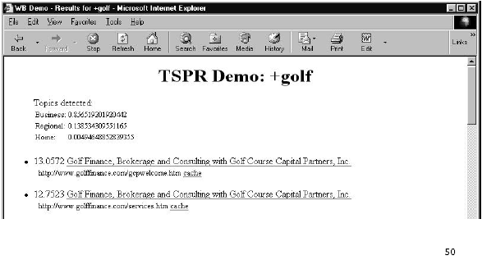
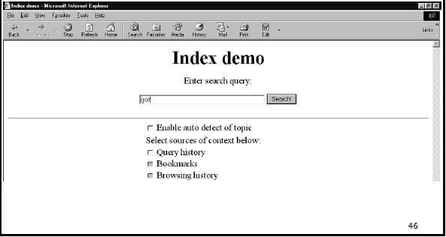
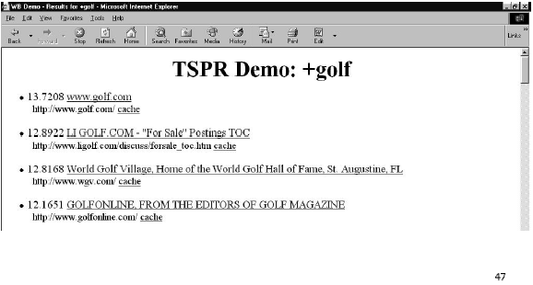
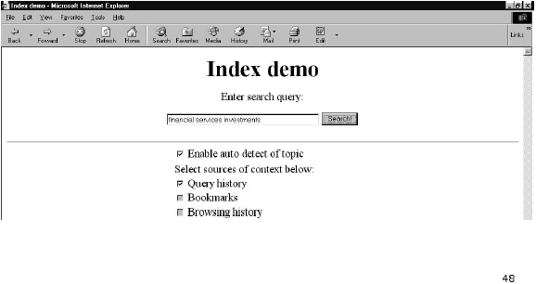
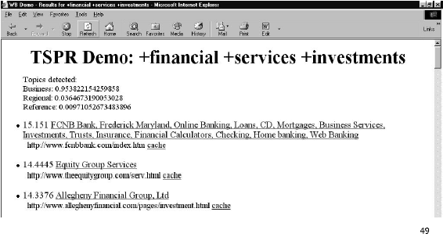
Topic-Sensitive PageRank 7/7
Bratislav Stojanović (unimatrix0@live.com) | Page 27/29

Slide 28
Conclusion
Implicitly makes use of IR (Information Retrieval) in determining the topic of the query
However, this use of IR is NOT vulnerable to manipulation, because ODP is compiled by thousands of volunteer editors
Using a small basis set is important for keeping the query-time costs low
Future work :
  Use finer grained basis set
  Weighting scheme based on page similarity to ODP category, rather than page membership to ODP category
Bratislav Stojanović (unimatrix0@live.com) | Page 28/29

Slide 29

Questions and Discussion
Yes?
Bratislav Stojanović (unimatrix0@live.com) | Page 29/29

